Slide 1

Final Presentation
17013253 Yongho_Choi
2019.Fall.PatternRecognition with

Slide 2
INDEX
Version_Intro
Algorithm_review
Github_
Discussion & Reference_
2019.Fall.PatternRecognition with

Slide 3
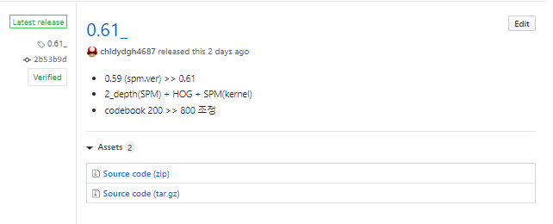
Version_Intro
0.61 (Codebook +800)
0.59 (StandardScaler)
0.57 (spm_feature)
0.52 (spm_image)
0.50 (not_spm_kernel)
0.41 (base_0_depth)
Final Ver.
2019.Fall.PatternRecognition with

Slide 4
Algorithm_review
Data
Feature Extraction
(Dense Sift)
After reshape,
train_fea.shape (3133440, 128)
Step_size = 8, img_size = 256
MiniBatchKmeans
(Codebook)
to_csv
CodeBook = 800
SPM
( Histogram )
Predict
C : 0.001
Gamma : 1e-07
StandardScaler
Merge histogram into matrix to decide similiarity
GridSearchCV + SVM
( SPM kernel )

Slide 5

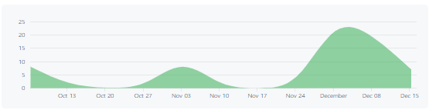
Github_
Github Link
https://github.com/chldydgh4687/PRproject
2019.Fall.PatternRecognition with

Slide 6
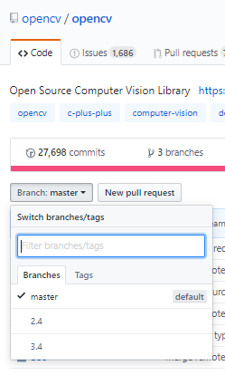
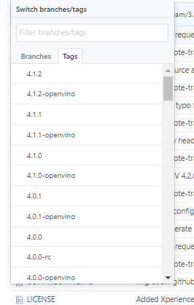
Github_
Branch Design Example
https://github.com/opencv/opencv
2019.Fall.PatternRecognition with

Slide 7
Github_
Branch Design
0.4x
: 가장 최근의 0.4x 버전을 배포하는 공간
master
0.5x
: 가장 최근의 0.5x버전을 배포하는 공간
0.6x
: 가장 최근의 0.6x 버전을 배포하는 공간
Develop
: 개발 로그 및 수정 사항 기록
Hotfix
: .ipynb 파일 백업본
2019.Fall.PatternRecognition with

Slide 8
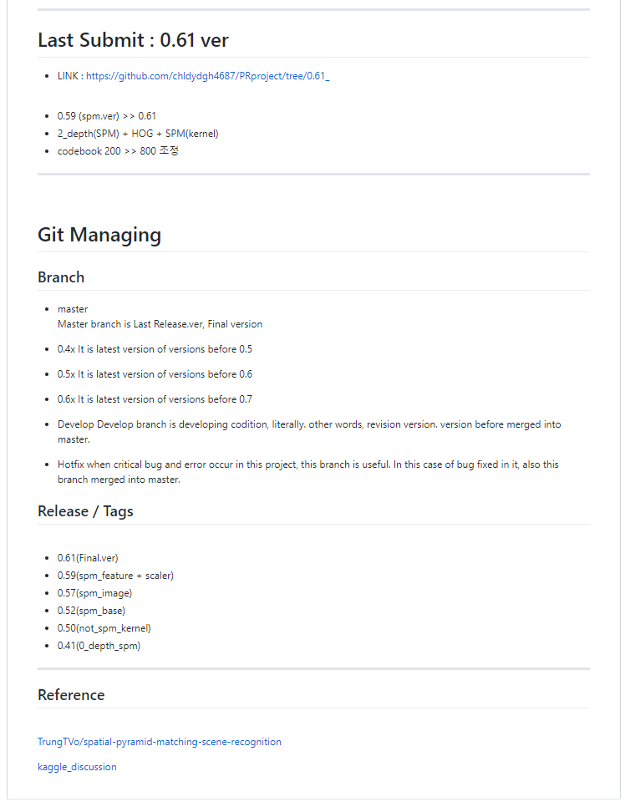
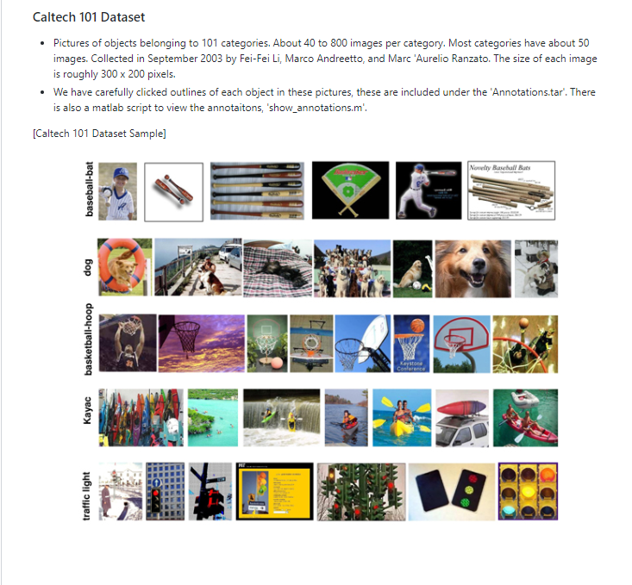
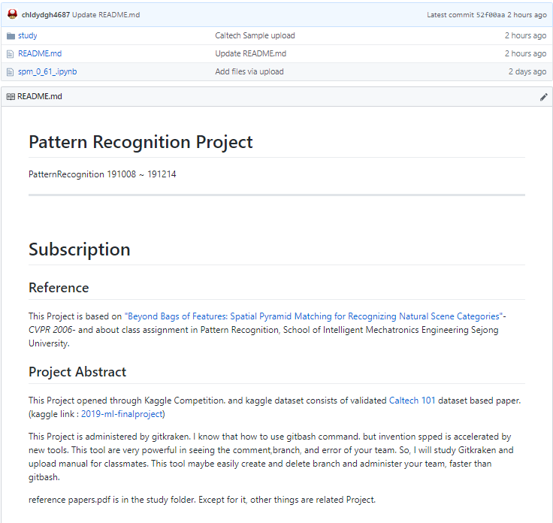
Github_
master
2019.Fall.PatternRecognition with

Slide 9
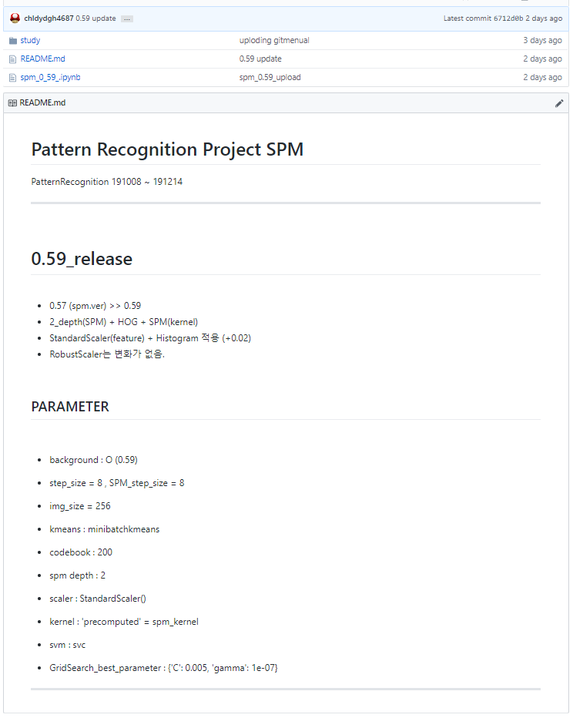
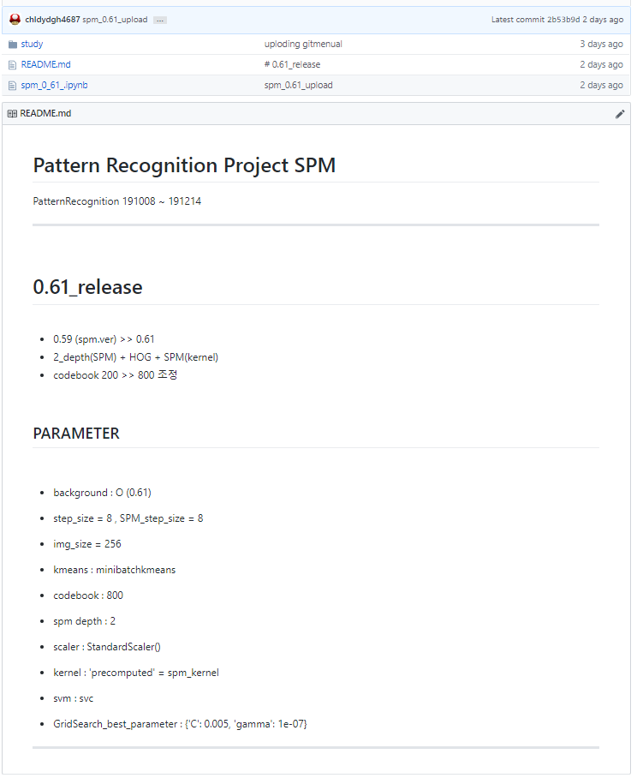
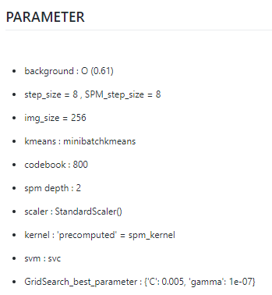
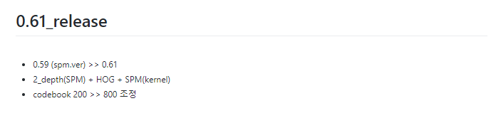
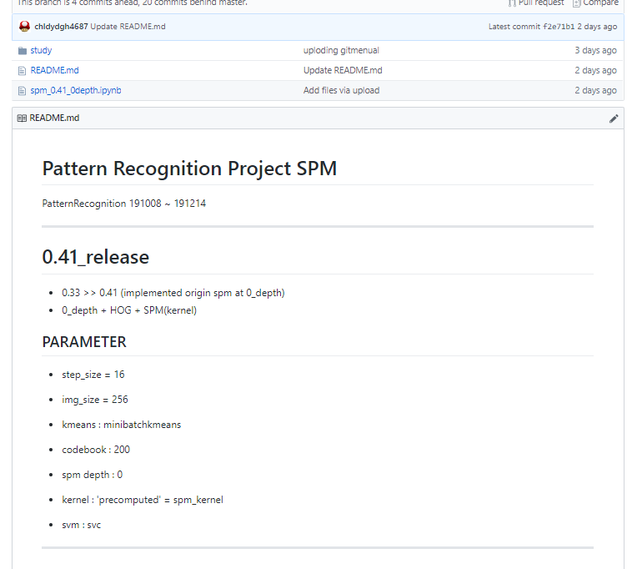
Github_
0.4x, 0.5x, 0.6x
2019.Fall.PatternRecognition with

Slide 10
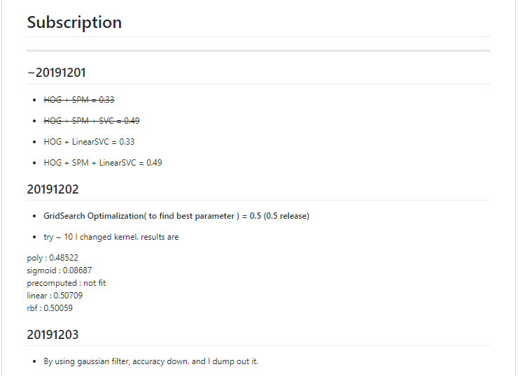
Github_
Develop
2019.Fall.PatternRecognition with

Slide 11
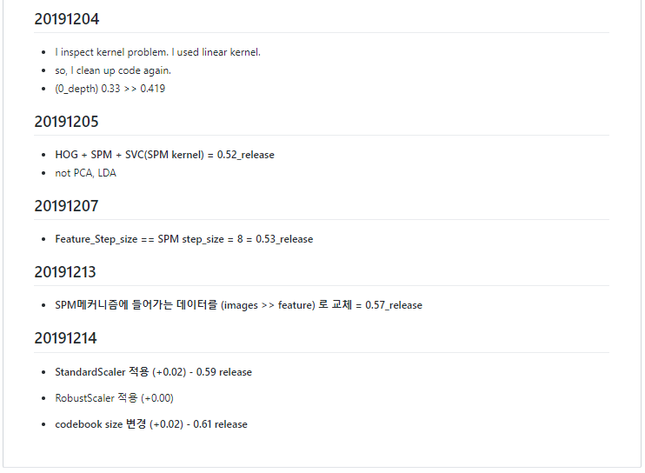
Github_
Develop
2019.Fall.PatternRecognition with

Slide 12
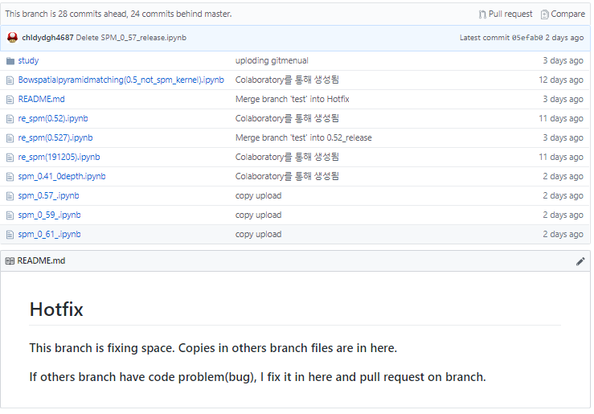
Github_
Hotfix
2019.Fall.PatternRecognition with

Slide 13
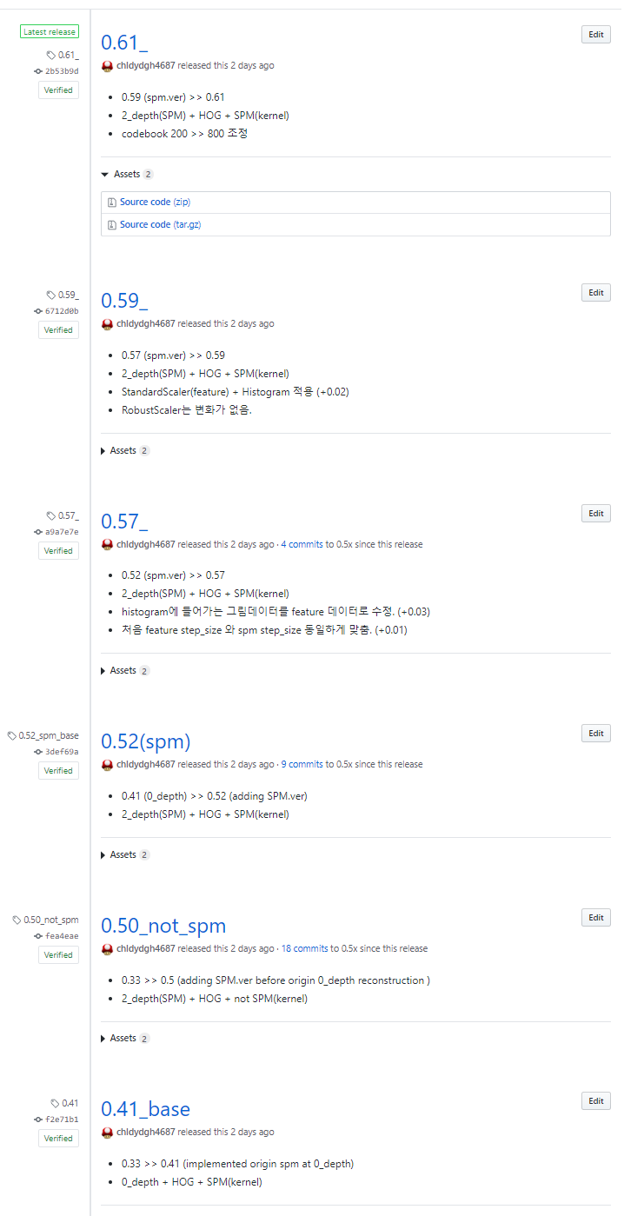
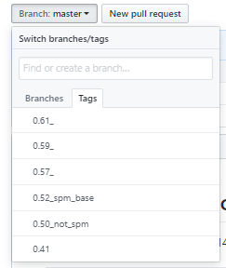
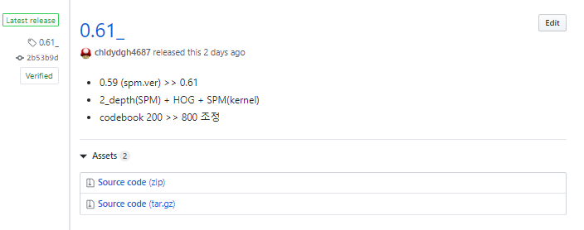
Github_
Release / Tags
2019.Fall.PatternRecognition with

Slide 14



Discussion_
Markdown, git_bash를 사용하는데 어려움이 있는 분들을 위해서 Markdown, application(Github desktop, Gitkraken) 가이드를 제시.
앞선 매뉴얼에 심화 내용으로, 클린한 branch를 위해서 Relase / Tags 에 대한 실습 가이드를 제시.
마감일 전까지 0.52에서 삽질했던 이유와 해결방안에 대해 서술.
2019.Fall.PatternRecognition with

Slide 15
Reference_
Paper
Beyond Bags of Features: Spatial Pyramid Matching for Recognizing Natural Scene Categories
http://vision.stanford.edu/teaching/cs231b_spring1213/papers/CVPR06_LazebnikSchmidPonce.pdf
Code
TrungTVo
https://github.com/TrungTVo/spatial-pyramid-matching-scene-recognition
Discussion in Kaggle
https://www.kaggle.com/c/2019-ml-finalproject/discussion
Github
Branch knowledge
https://gmlwjd9405.github.io/2018/05/11/types-of-git-branch.html
2019.Fall.PatternRecognition with

Slide 16
Final Presentation
Thank you.. ☺
2019.Fall.PatternRecognition with

